Slide 1


VIOLET NEXUS TECH SERVICES S.L.
Company profile
CORPORATE PRESENTATION
European market expertise, focused on colocation
and integrated ICT delivery
Notes:
English translation of the latest approved Chinese company presentation, VNT_公司介绍_中文.pptx, slide 1. The data center images are illustrative images generated with OpenAI ImageGen. They do not depict a specific VNT facility, project or employee.

Slide 2
About VNT
Your local partner for IT infrastructure deployment in Europe.
Local operations in Spain
Colocation project delivery
Local ICT services in Spain for international clients
with business operations in Europe.
Experience across multiple data center projects
and familiarity with local implementation requirements.
Established data center partnerships
ICT implementation and outsourcing
Longstanding data center relationships, with agency
authorization from selected providers.
Network and IT infrastructure expertise for project
implementation and outsourced technical support.
Notes:
English translation of the latest approved Chinese company presentation, VNT_公司介绍_中文.pptx, slide 2. Icons are retained from the source presentation.

Slide 3

ICT infrastructure services
Colocation at the core, with network management and local project delivery in Europe.
01
Network infrastructure management
Equipment supply, deployment and ongoing maintenance.
02
Hardware supply and integration
CORE SERVICE
Network, server and storage selection and installation.
Data center
colocation
03
Onsite deployment
Rack installation, cabling and basic configuration.
Colocation options for rack, power and
connectivity requirements, with commercial
coordination, rack installation and
network access support.
04
Local project coordination
Liaison with data centers, suppliers and onsite teams.
05
Outsourced technical support
Remote and onsite services, with expansion support.
Notes:
English translation of the latest approved Chinese company presentation, VNT_公司介绍_中文.pptx, slide 3. Icons are retained from the source presentation.

Slide 4

Data center colocation
Through our data center partners in Spain, we coordinate
colocation resources, commercial discussions and local
project delivery for international clients.
01
Colocation planning
Options matched to rack capacity, power density, connectivity needs
and project delivery schedules.
02
Solutions and commercial liaison
Longstanding relationships and agency authorization from selected
data centers support solution planning and contract coordination.
03
Rack installation and network access
Coordination of site access, equipment installation and connectivity,
with support for project testing and acceptance.
04
Handover and operational support
Documentation handover and coordination of local data center
requirements, followed by ongoing operational support.
Notes:
English translation of the latest approved Chinese company presentation, VNT_公司介绍_中文.pptx, slide 4. The data center images are illustrative images generated with OpenAI ImageGen. They do not depict a specific VNT facility, project or employee.

Slide 5
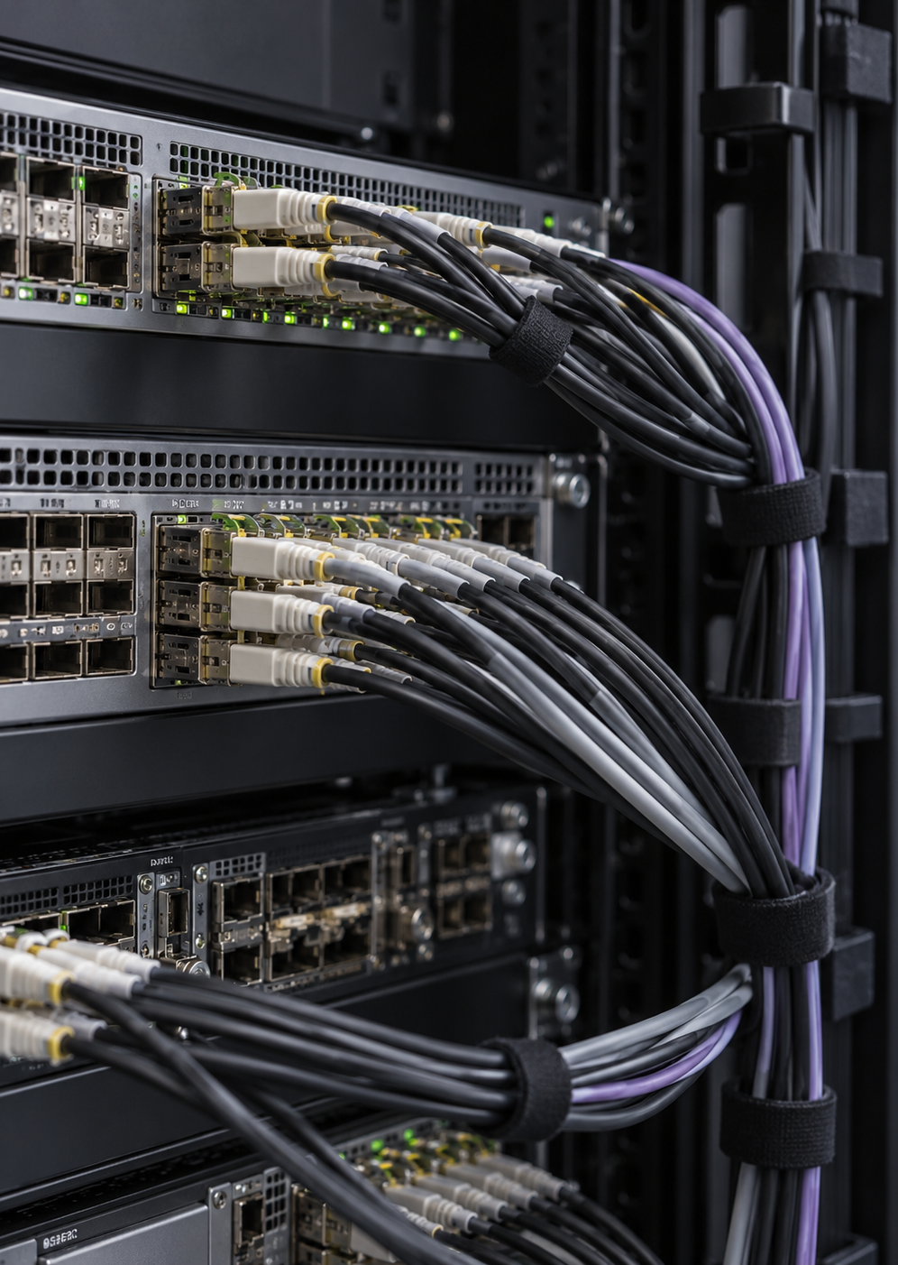
Managed service for network infrastructure
VNT supplies, deploys and maintains the equipment.
Clients use it under contract, without purchasing it.
Planning and deployment
Supply and ownership
Equipment selection, installation and configuration through to commissioning.
VNT funds procurement and
retains equipment ownership.
Ongoing maintenance
Contract and service scope
Routine management and fault resolution, with changes and expansion as needed.
The contract defines usage rights, service duration and support arrangements.
Notes:
English translation of the latest approved Chinese company presentation, VNT_公司介绍_中文.pptx, slide 5. The data center images are illustrative images generated with OpenAI ImageGen. They do not depict a specific VNT facility, project or employee.

Slide 6

European delivery and integration
Hardware supply, onsite implementation and outsourced technical
support for international clients with projects in Europe.
01
Hardware selection and supply
Selection and procurement of network, server and storage equipment,
with installation and setup.
02
Onsite installation and commissioning
Rack installation, cabling and basic configuration,
with system testing and commissioning support.
03
Local project coordination
Coordination with data centers, suppliers and onsite teams
on equipment arrivals, site access and project handover.
04
Ongoing technical support
Remote and onsite support for maintenance, configuration changes
and subsequent expansion.
Notes:
English translation of the latest approved Chinese company presentation, VNT_公司介绍_中文.pptx, slide 6. The data center images are illustrative images generated with OpenAI ImageGen. They do not depict a specific VNT facility, project or employee.

Slide 7

We look forward to
working with you
Local support in Europe and ICT infrastructure services
service@vntservice.com
VIOLET NEXUS TECH SERVICES S.L.
Notes:
English translation of the latest approved Chinese company presentation, VNT_公司介绍_中文.pptx, slide 7. The user-supplied globe is a conceptual illustration. Its connections do not represent actual network coverage.

